Slide 1
Web-Based Disease-Pathway Association Extraction from Biomedical Article
Bora Yöntem 150130806
Ömer Faruk Davarcı 150160048
Advisor: Prof. Dr. Ali Çakmak

Slide 2
Motivation
There is big data about medical
There is NLP
There is a need about practical tool
May be Start Up :)
Notes:
Bu projede büyük veri ile karşılaşma şansımız oldu. Bu veriyi kullanmak için docker, redis gibi farklı uygulamaları da kullanma şansımız olacak.
Yine bu projede, yapay zekanın bir alt alanı olan NLP gibi çok güncel ve popüler kavramla ilgilenme şansı kazanacağız.
İnternet deki araştırmamıza göre, bu proje sonunda oluşturmak istediğimiz web applikasyonu daha önce yapılmamış. Bunu yaparak hem araştırmacılara destek vermek hemde makale tarama süreleri kısaltmak, ayrıca uygulama içinde kendi sosyal mecrasını oluşturabilirsek bir start up a dönüşmesini sağlamak.(En azından denemek :) )
Google Translate
In this project, we had the chance to encounter big data. We will have the chance to use different applications such as docker and redis to use this data.
Again in this project, we will have the chance to deal with a very up to date and popular concept such as NLP, a sub-field of artificial intelligence.
According to our research on the internet, the web application we want to create at the end of this project has not been done before. By doing this, we want to support researchers. In addition, if we can create its own social media within the application, it will turn into a start-up. (at least we want to try :) )

Slide 3
Pathway
What is metabolic pathway?
Why is important?
Notes:
MP: Simply Metabolic pathways can be described as a series of chemical reactions that start with a substrate and finish with an end product.
WHY: Thousands of metabolic pathways exist and most involve multiple steps – some can be hundreds of steps long! All metabolic pathways together form a complex network that is necessary to maintain life.

Slide 4
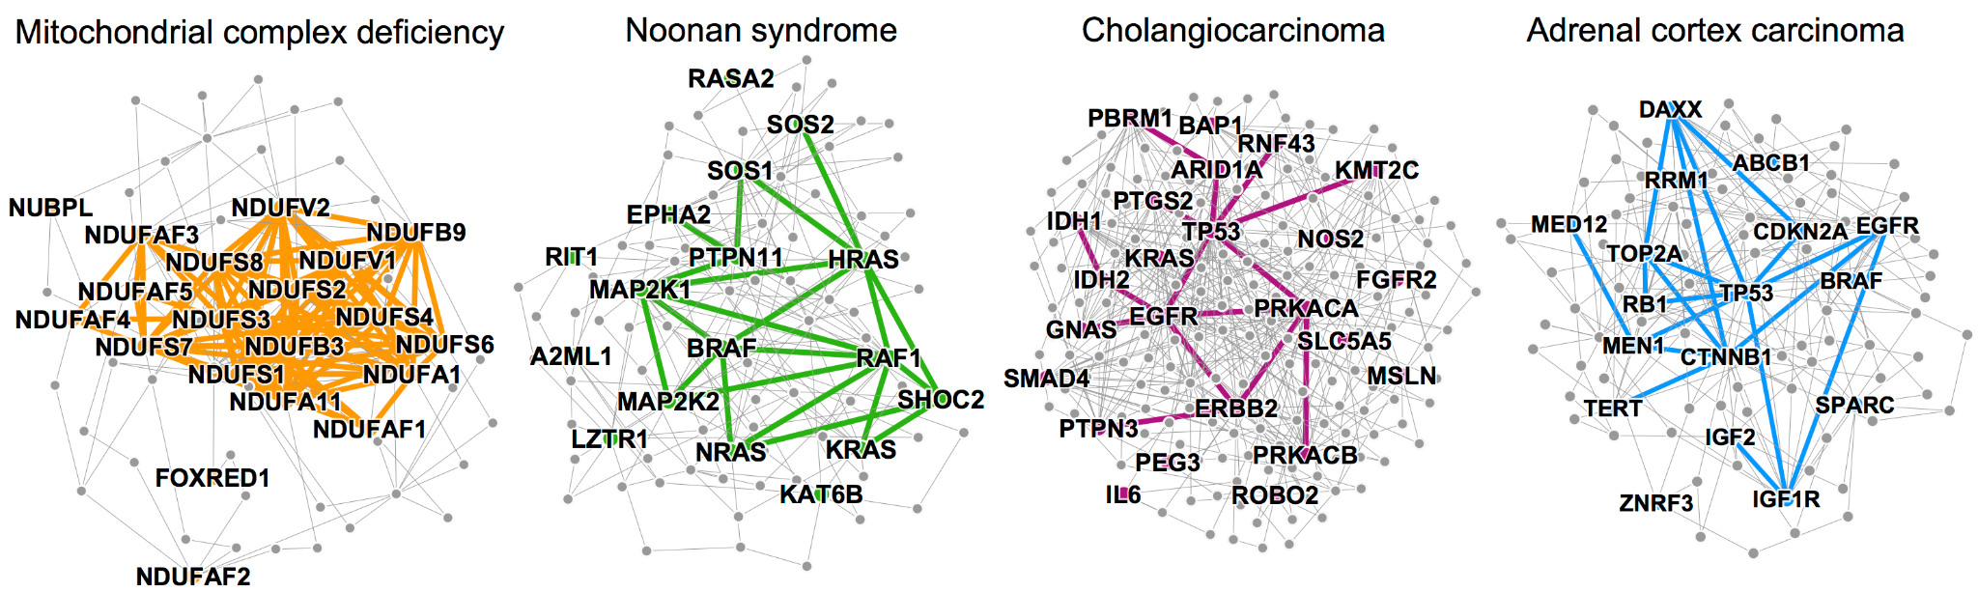
Notes:
http://snap.stanford.edu/pathways/ =>picture website
An image taken from an article on Discovering disease pathways information in Standford University Research Lab. As you can see in the picture, the graph relationship between 4 different diseases and the protein-disease pathways they are connected to is given.
As we can see in the complex disease-pathway-protein relationship on the screen, researchers may need information on metabolic pathways in their studies on diseases. There are also researchers who only research metabolic pathways. Accessing Disease-Metabolic pathway information is very important for these researchers.
With our project, we aim to inform the researchers working on the disease-metabolic pathway that the pathway information they seek increases, decreases or does not undergo any changes. In this way, the researcher can reach the desired information in a short time and can spend more time on his work/project by scanning less articles.

Slide 5

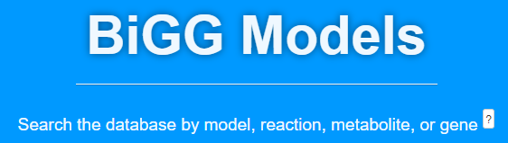
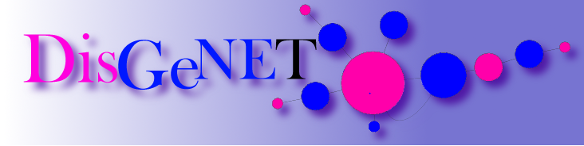
Big Data
Notes:
Projede kendi veritabanımıza aktardığımız dataları aldığımız open source kaynaklar:
Articles data: We got it from Europe PMC is an archive of life sciences journal literature open source for abstract
Reactions and Metabolites: We got it from BiggModels
Disease data :We got it from DisGeNET is a discovery platform containing one of the largest publicly available collections of disease

Slide 6
Steps of Project
Collect data from Open Source medical databases
Parse data and Insert into our database
Develop named entity recognition model to find pathways
Use pre trained named entity recognizer to find diseases
Associate pathways and diseases from abstract text of articles
Find an association score with pre trained sentiment analyzers
Insert association records into table
Create materialized views from association table to report data
Create Web GUI for users
Integrate client side to API

Slide 7

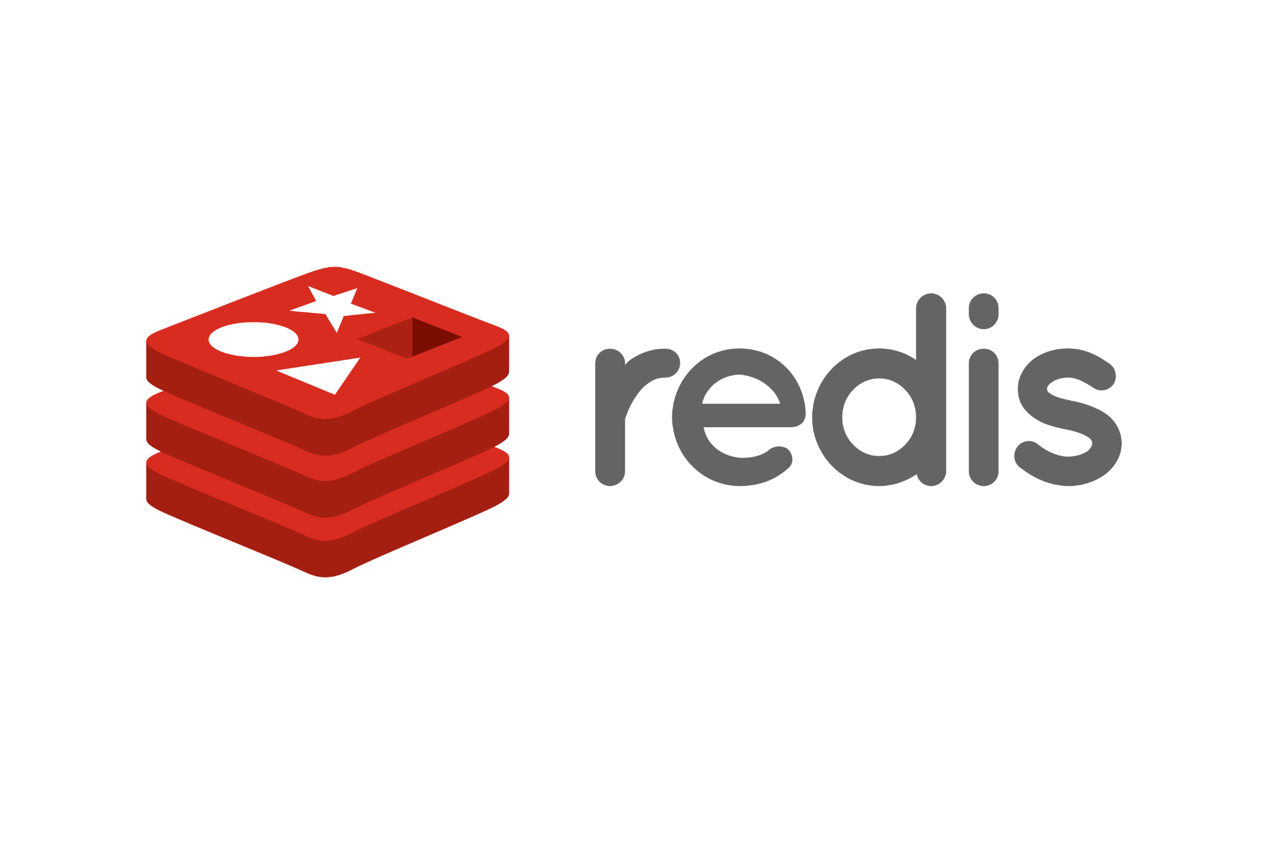

API - Database
Notes:
We developed api with django rest framework. We have found a free postgresql database provider, so we choose that. Also postgresql is a good choice in terms of indexing, storing and searching numerous structured data types.
We have redis. Redis is an in-memory data structure store, used as a distributed, in-memory key–value database, cache and message broker, with optional durability.
We used it to speed up response time to API queries. Our data is not in a structure that changes very often. That's why we made the caching time limit 1 week.

Slide 8
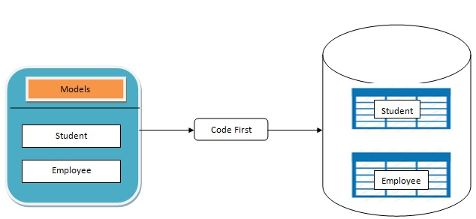
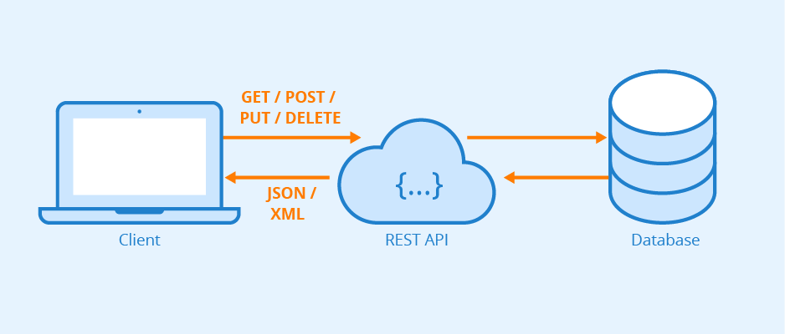
API Design
Notes:
We have code first api design. That means we are not creating any table or entity to database. We are defining models with attributes. The framework creates a table with columns which are attributes of model.
We have have rest api. There is crud operations to each model. Our response type of data is json.

Slide 9
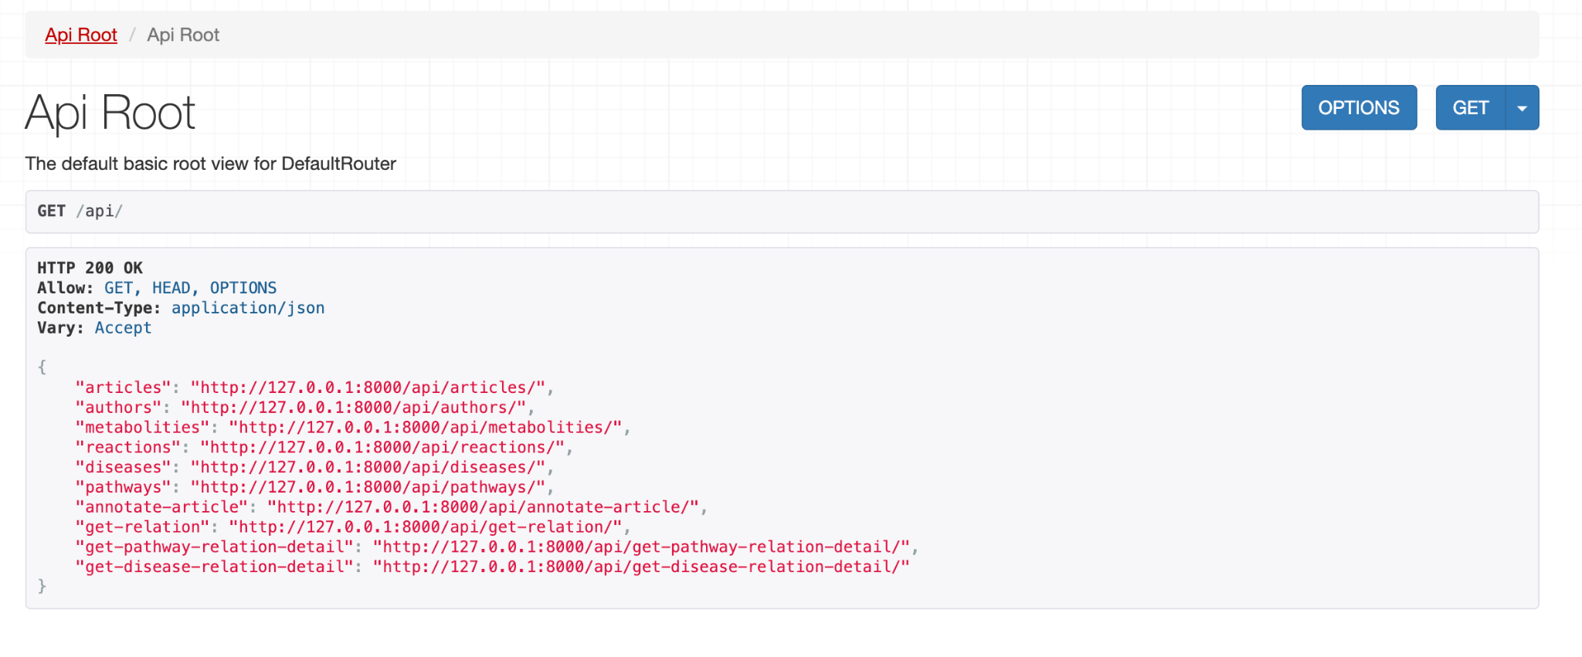
API Design
Notes:
We have ten endpoints. Some of them have allowed to just get method. Because they only exist to return the desired data from the views for web interface.

Slide 10
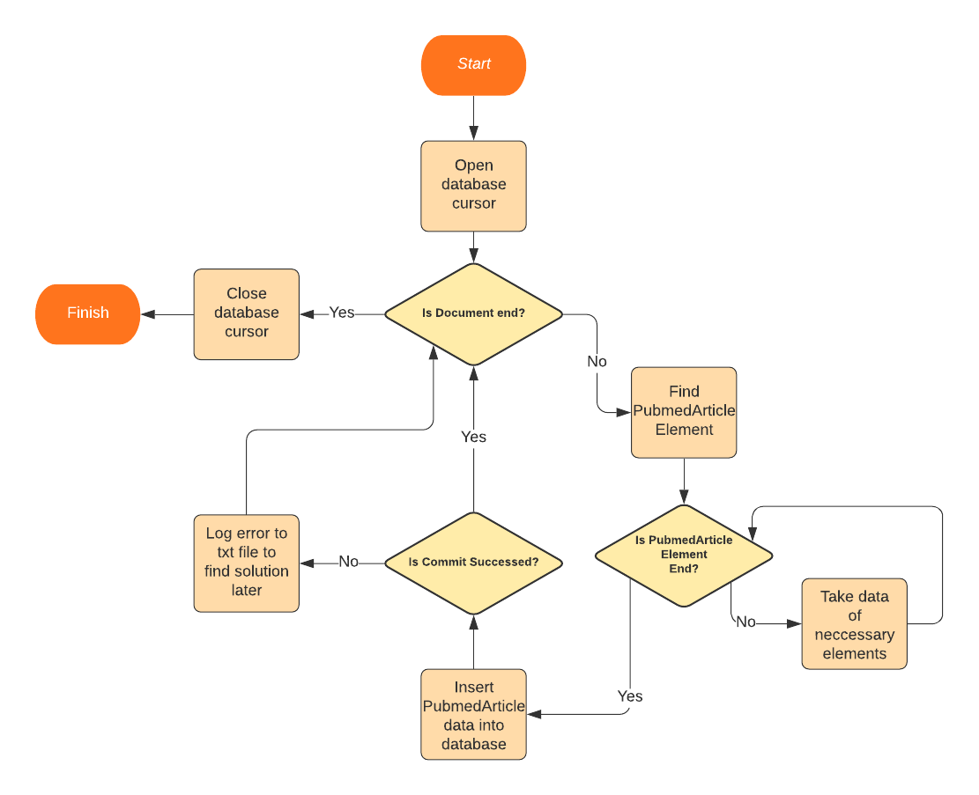
Data Extractor
Notes:
We firstly download gzip files from open sources like pubmed.
We added data to our database with our own services with the help of xml.sax content handler.
We made python scripts.
The flow seen on the slide screen is the overall flow of the script.
The parser can detect xml elements. The PubmedArticle element is the parent of all other elements we wanted.
So after we are in PubmedArticle element, we are collecting data. When it is end, we are inserting data into database.
There 30,000 article in each gzip. It takes almost 2 hours to insert all of them.

Slide 11
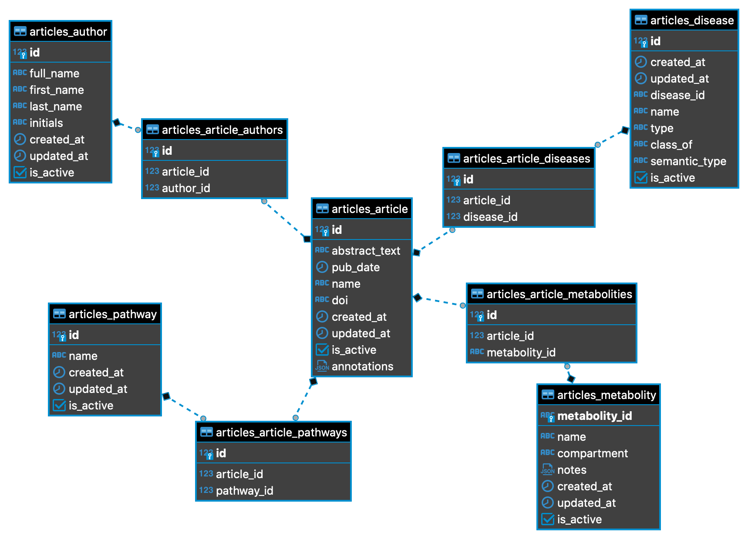
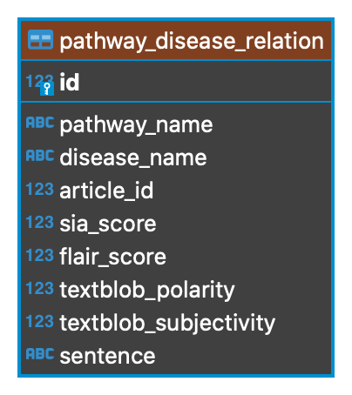
Database Design
Notes:
We have 5 data table and we have 4 relationship table. Our main table is article. It has 4 relation. It has many to many relations with pathway, author, disease and metabolity tables.
We have pathway_disease_relation table. In this table, pathway name, disease name, article id and sentence are unique together. This table has sentiment score analysis of sentence that includes pathway name.
It also includes sentence data that used to analyze. We reporting data at web interface thanks to this table.

Slide 12
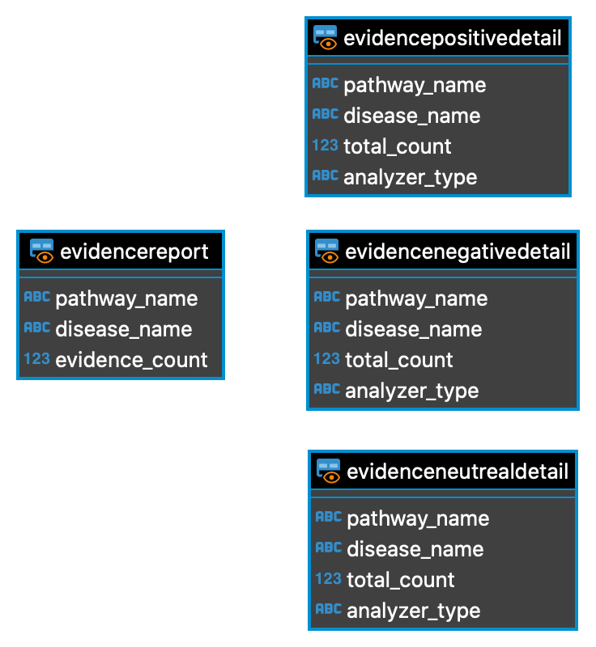
Database Design
Notes:
We have 4 materialized views created from pathway_disease_relation table. Materialized views are faster than tables when querying. We have data that is not changing oftenly.
So we created these 4 views in order not to write complex queries while showing our data on the screens.
Evidencepositivedetail, evidencenegativedetail and evidenceneutrealdetail views are vertical. We can reduce analyzer_type column and we can separate these 3 views to 9 views.
But now we do not need that. Detail table have rows that keep information on how many evidence there are according to the model type. Tables are differing from each other with sentiment analysis of information.

Slide 13
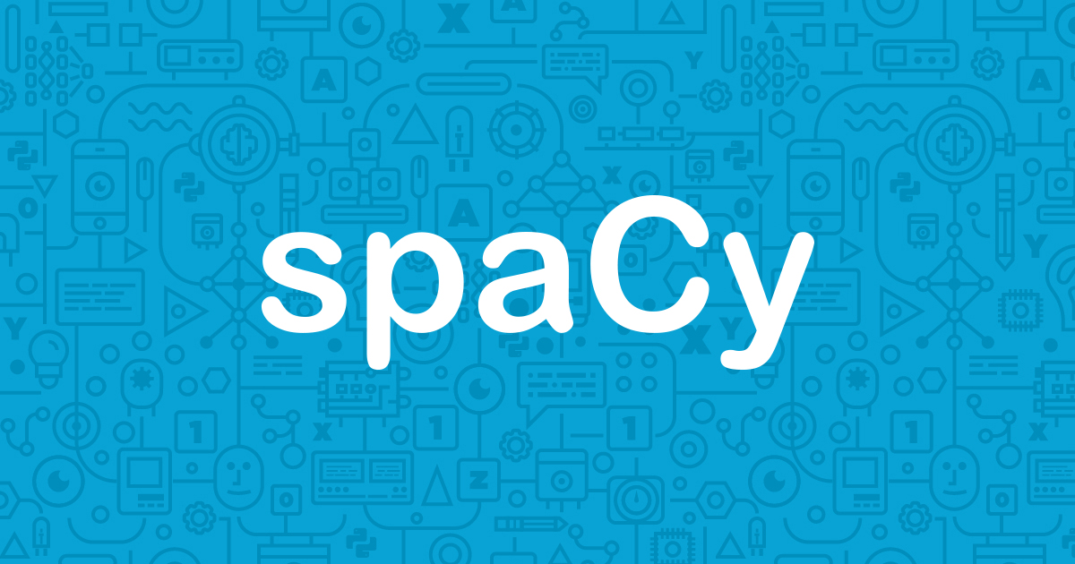
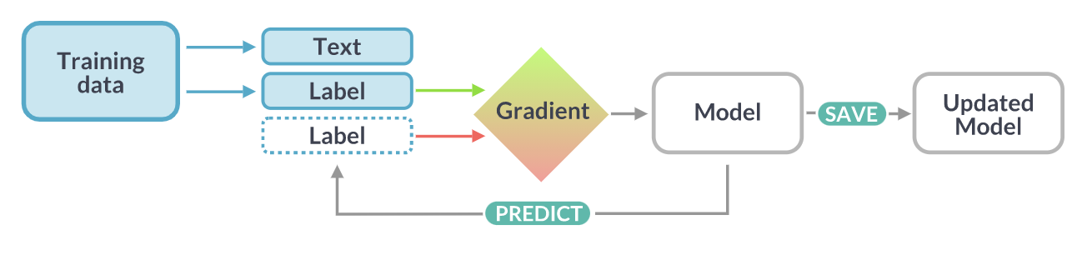
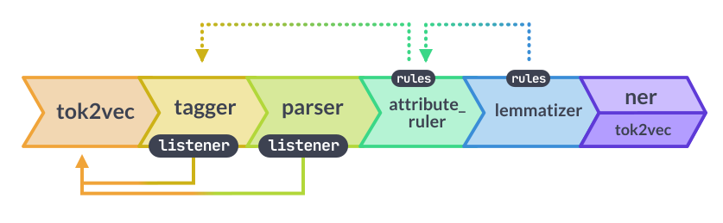
NER Model
Create NER model
Create train data
Create evaluation data
Train the model with annotated data
Give entity patterns to increase performance
Test model
Annotation Tool
Notes:
We trained a new named entity recognition model for pathway. How we did that? We used spacy to create model. It is so useful framework to work with.
First, we annotated articles with a tool that we developed. Then trained the model with annotated data.
We also added patterns to our model to recognize some pathways. It do not just recognize pathways which we learned.
It come up with a pathway across unseen data thanks to spacy pipelines.

Slide 14

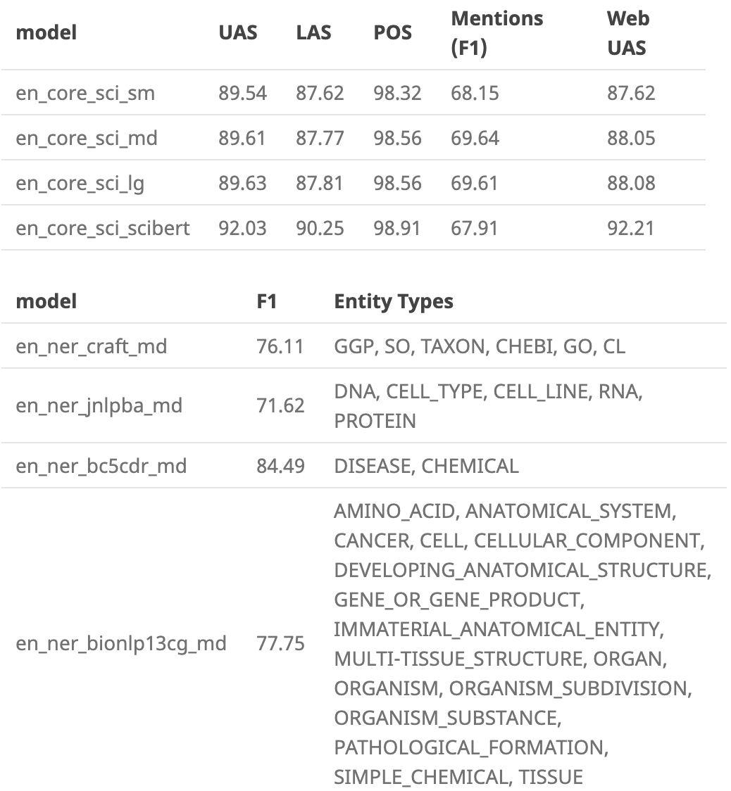
NER Model
NER Models
Disease (pre trained)
Pathway (trained)
Notes:
We used a pre trained model to recognize diseases. Because the en_ner_bc5cdr_md has valuable f1 score.
It was enough to meet our needs.

Slide 15


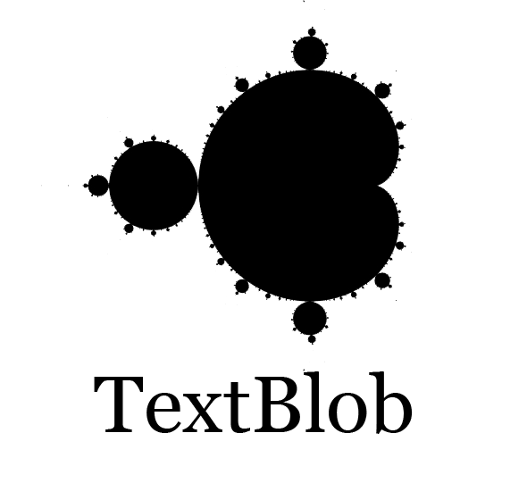
Sentiment Analysis
NLTK
Flair
TextBlob
Notes:
We used three different sentiment analyzer to analyses sentence that includes pathway.
The NLTK and TextBlob are good to analyze, but flair is good to analyze with pre trained version.
The flair could not find any neutral sentiment of any sentence from our data. It scores either positive or negative.
That is thing to improve in future.

Slide 16
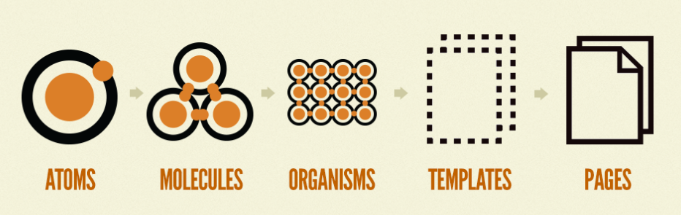
Atomic Design for Our Web App
Notes:
While preparing the web application, we found it appropriate to proceed with a specific design pattern for our website. We decided to use the Atomic Design methodology.
So what is this atomic design: the methodology for creating design systems. Atomic Design is a methodology inspired by chemistry. Just as all matter is made out of atoms that combine to form molecules, which in turn make up more complex organisms, Atomic Design involves breaking a website down into its basic components and then working up from there to create a site.
It consists of five different levels.

Slide 17

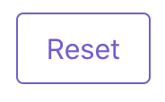
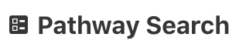
Atoms
Notes:
Atoms: Tasarım metodolojimizin yapı taşıdır. Web arayüzlerine uygulanan atomlar, form label, input veya button gibi HTML etiketlerimizdir. Yazı tipi, renk ve animasyon gibi daha abstract yapılarda atom kapsamında değerlendirebiliriz. Tek başlarına yararları olmasa da patternleri oluşturmamız için gerekli elementlerdir.
Atoms: It is the building block of our design methodology. Atoms applied to web interfaces are our HTML tags like form label, input or button. We can evaluate it within the scope of atom in more abstract structures such as font, color and animation. Although they are not useful on their own, they are essential elements for us to create patterns.

Slide 18
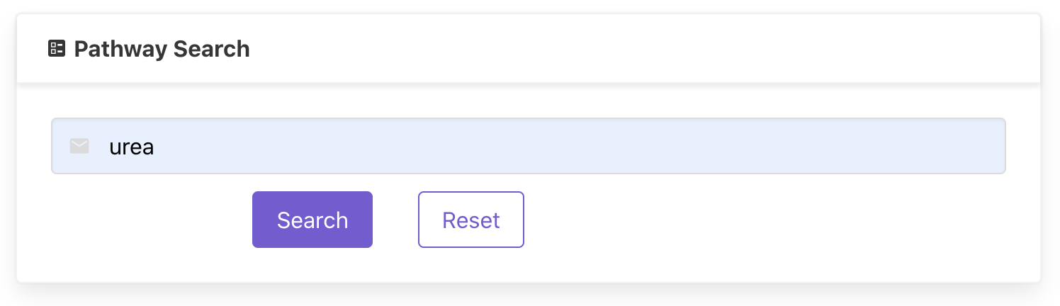
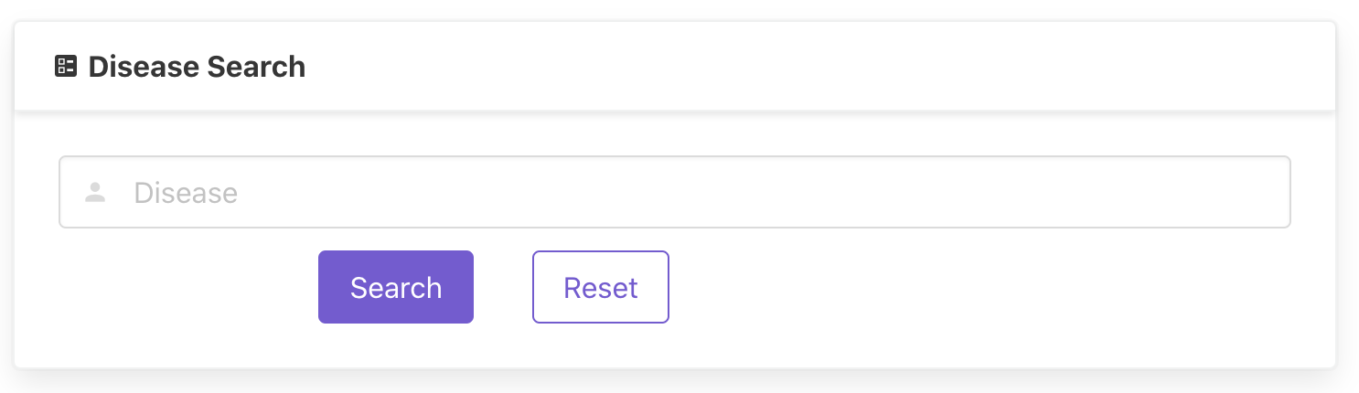
Molecules
Notes:
Molceules: Atomlar tek başlarına yararlı olmadıkları için yavaş yavaş onları bir araya getirmeye başlarız. İşte Moleküller birbirine bağlı atomlardan oluşan yapılardır. Bileşenlerin yapı taşlarıdır. Bu yapıtaşları sayesinde tasarım sistemimizin omurgasını oluşturmaya başlarız.Örneğin label,input ve button tek başlarına pek yararlı olmasa da bunları bir form olarak birleştirirsek bir anlam ifade etmeye başlar. Atomlar molekülleri oluştururken “bir şeyi yap ve onu iyi yap” prensibi ile oluşturulmaktadır.
Molecules: Since atoms alone are not useful, we gradually begin to put them together. Molecules are structures made up of atoms connected to each other. They are the building blocks of components. Thanks to these building blocks, we begin to form the backbone of our design system. For example, although label, input and button are not very useful on their own, if we combine them as a form, it starts to make sense. When atoms form molecules, they are formed with the principle of "do one thing and do it well".

Slide 19
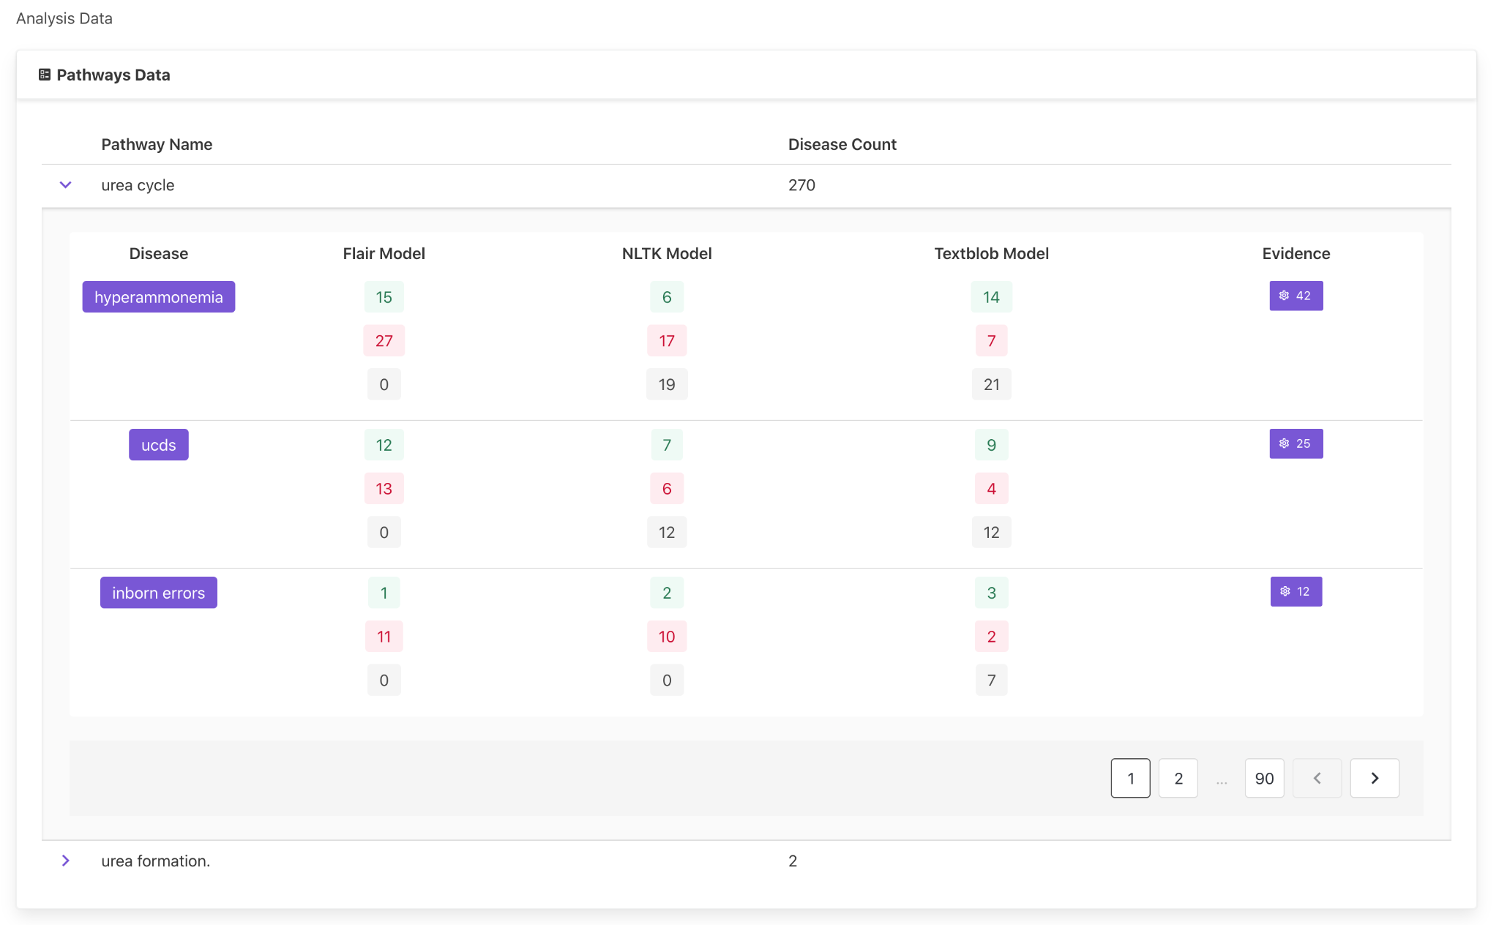
Organisms
Notes:
Organism: Moleküller bize çalışmamız için yapı taşları verir ve onları bir araya getirerek organizmaları oluştururuz. Organisms, bir ara yüzün nispeten karmaşık, farklı bir bölümünü oluşturmak için bir araya getirilen molekül gruplarıdır.Moleküllerden organisme kadar yapılanma, bağımsız, taşınabilir, yeniden kullanılabilir bileşenler oluşturmayı teşvik eder.
Organism: Molecules give us the building blocks to work with, and by putting them together we form organisms. Organisms are groups of molecules that combine to form a relatively complex, distinct part of an interface. Construction from molecules to organism promotes the creation of independent, portable, reusable components.

Slide 20
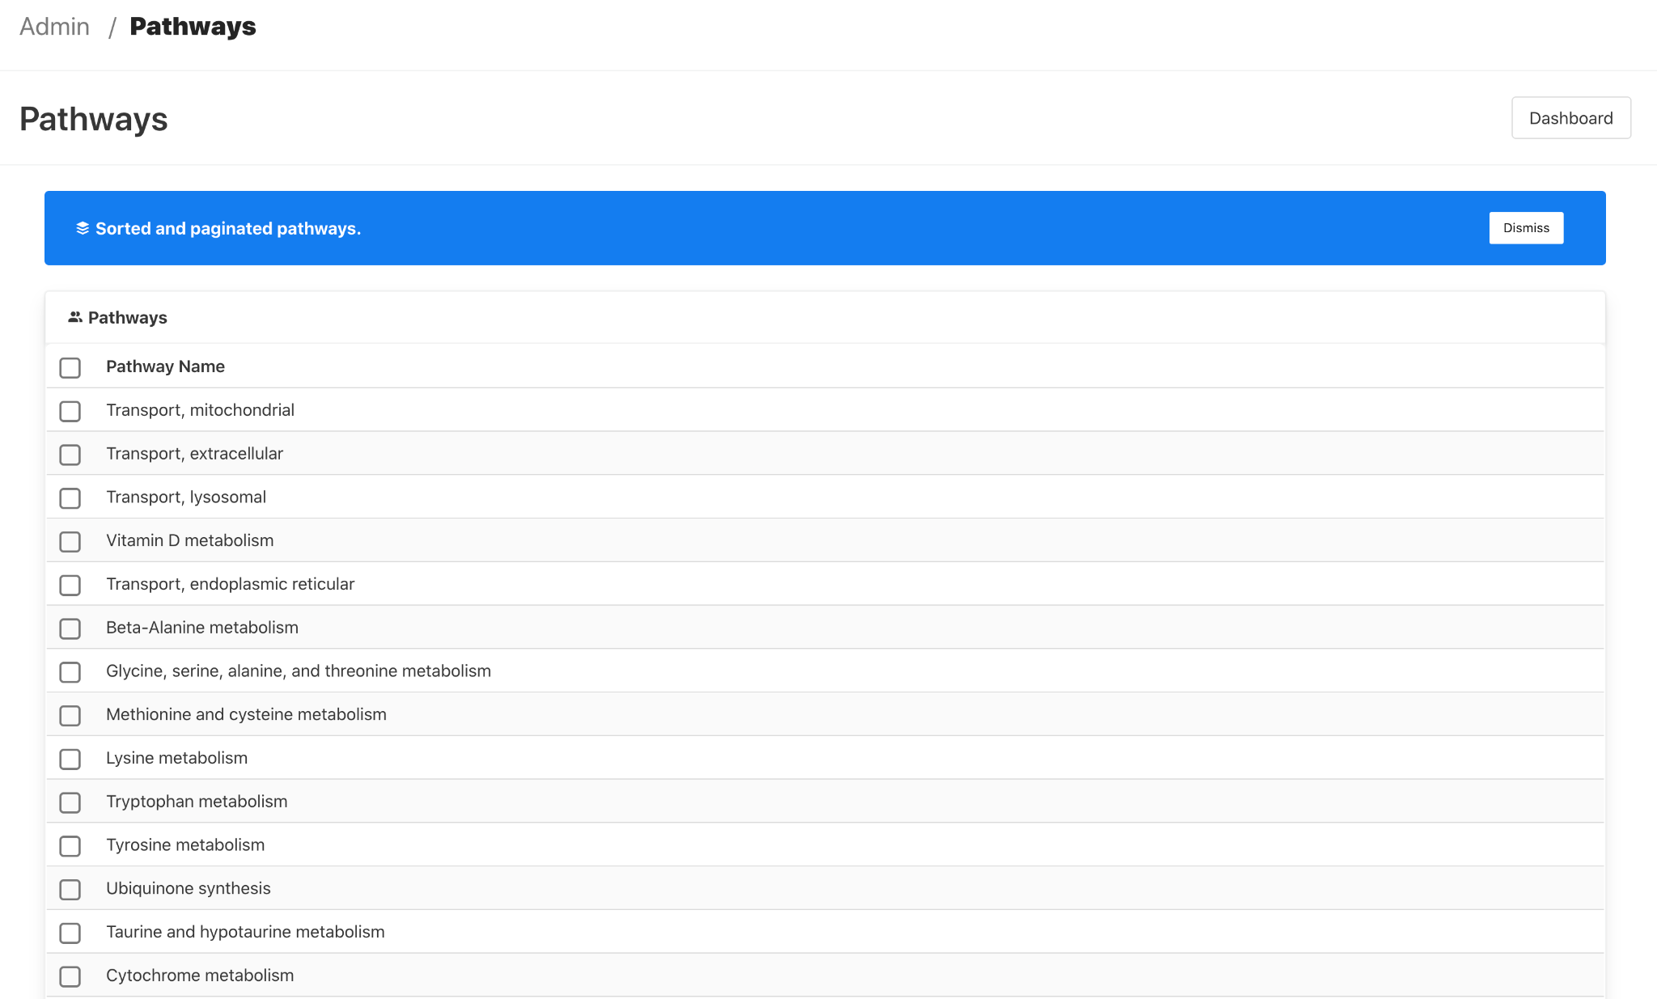
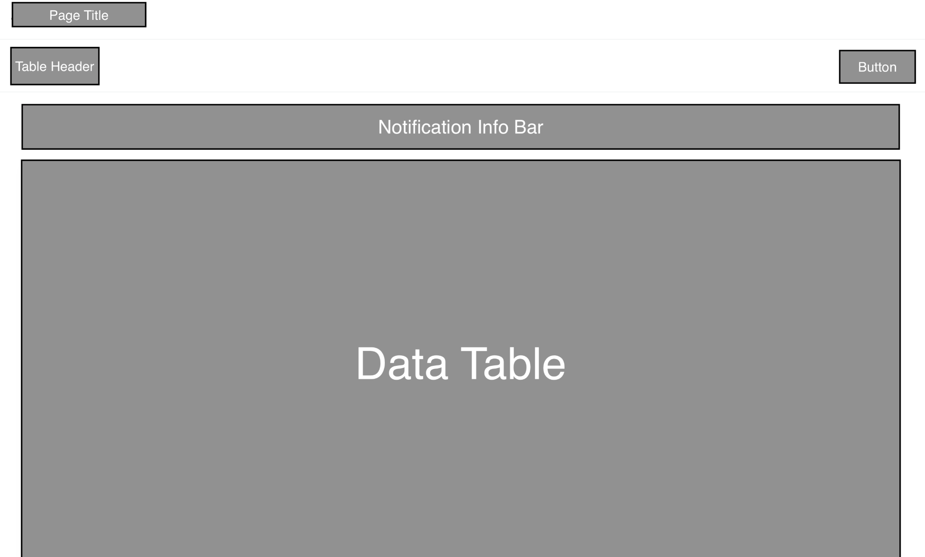
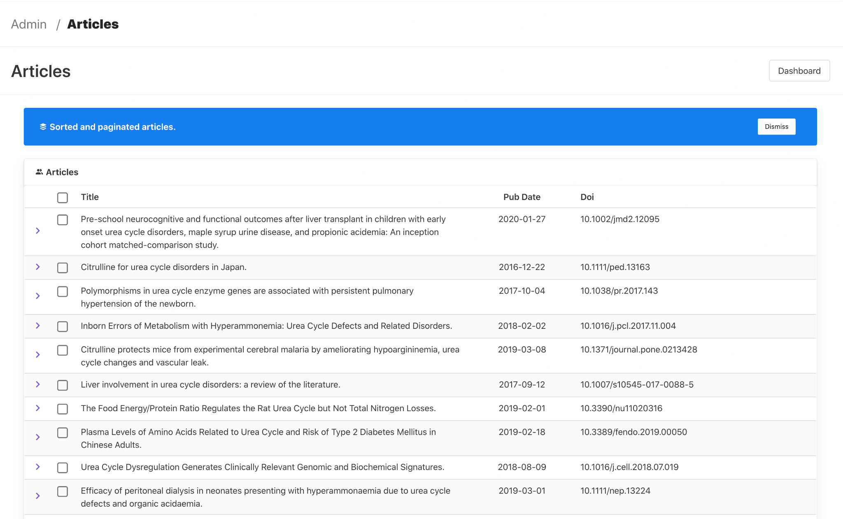
Templates
Notes:
Templates: Templateler, çoğunlukla sayfaları oluşturmak için bir araya getirilmiş organism gruplarından oluşur. Tasarımın belirli bir düzenle bir araya gelerek belirli bir işi görmeye başladığı alandır.Templateler hala çok somuttur ancak nihaii tasarımın yavaş yavaş görünmeye başladığı bir yerdir.

Slide 21
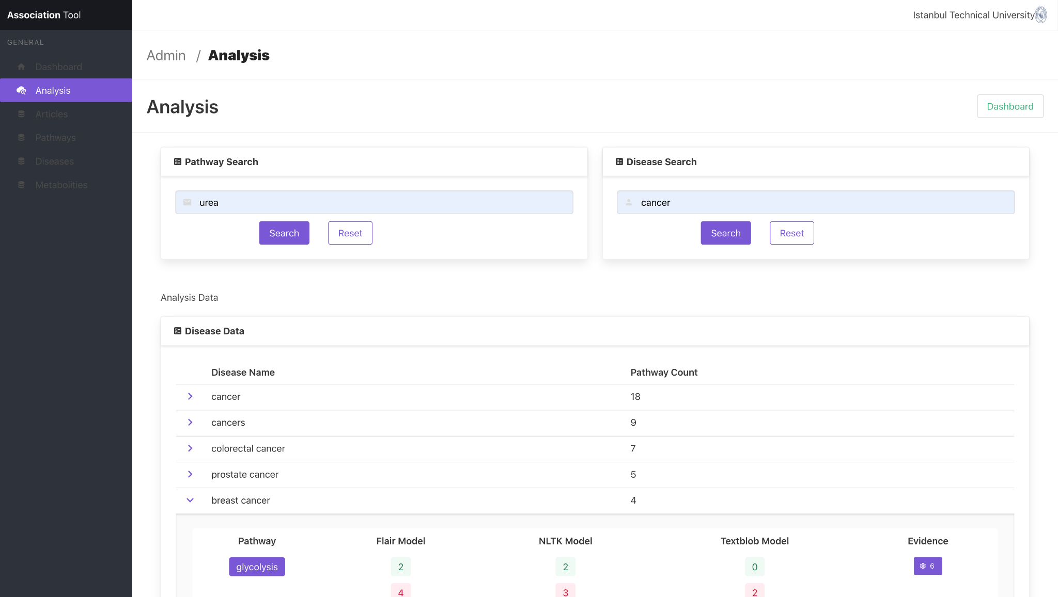
Pages
Notes:
Görmek istediğimiz, gerçekleştirdiğimiz hedefimizdir. Bir kullanıcının asıl göreceği alandır.

Slide 22
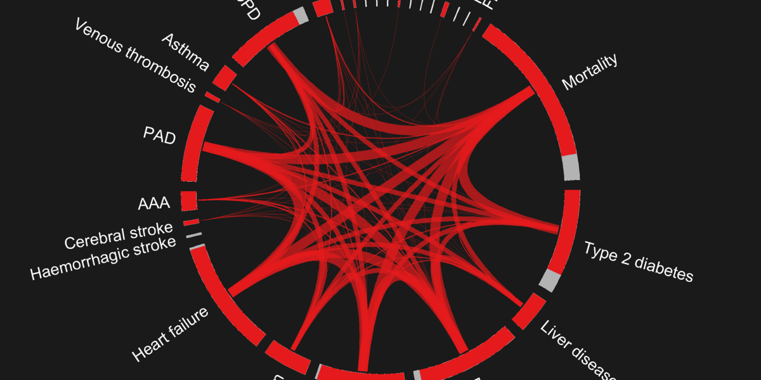
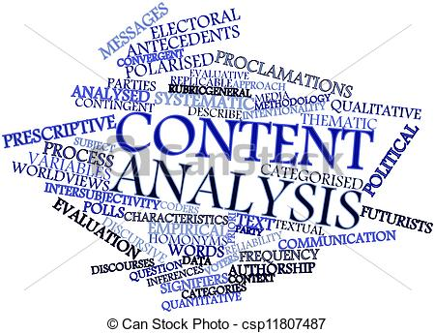
Future Work
Content Analyze
We just consider pathway
Text Extraction
Just not for PubMed, generaziable
More Comprehensive NER Model
Database normalization
ElasticSearch Integration
Notes:
Content Analysis: Projemizde modelimiz ile ortaya çıkardığımız puanlamayı içerikten bağımsız bir şekilde oluşturmaktayız. Projenin daha ileriki safhaları için içerik analiz yapılacak şekilde düzenlemeyi hedeflemekteyiz. Kullandığımız modeller (Flair,NLTK ve TextBlob Models) Twitter, imdb gibi veritabanlarından elde edilen veriler ile ortaya çıkan modellerdir. Ama biz medikal bir alana ait geliştirme yapmaktayız.Medikal alana dair bir model bulamadık. Projenin ileri evrelerinde medikal alana dair bir model geliştirmek istiyoruz.
Database Normalization: Analiz sayfasında sorgu sonuçlarını veritabanımızdaki görünümlerden (view) getirmekteyiz.Bunlar evidencepositivedetail,evidencenegativedetail ve evidenceneutrealdetail. Projenin veritabanımızdaki veri miktarı çok arttığı zaman bu tablolarda tutulan veri miktarı da artacağı için performans yönünden sıkıntıya düşebiliriz. Bu sebeple bu tablolarıda 3 er parçaya ayırabiliriz.
ElasticSearch, özellikle veri boyutunun çok artması ve raporlama ihtiyacı için bu entegrasyonu sağlayabiliriz.
Content Analysis: In our project, we create the scoring that we created with our model independently of the content. We aim to organize content analysis for the further stages of the project. The models we use (Flair, NLTK and TextBlob Models) are models that emerge with data obtained from databases such as Twitter and imdb. But we are developing a medical field. We could not find a model for the medical field. In the later stages of the project, we want to develop a model for the medical field.
Database Normalization: On the analysis page, we fetch the query results from the views in our database. These are evidencepositivedetail,evidencenegativedetail and evidenceneutrealdetail. When the amount of data in our database increases too much, the amount of data kept in these tables will also increase, so we may experience difficulties in terms of performance. For this reason, we can divide these tables into 3 parts.
We can provide this integration for ElasticSearch, especially for the large increase in data size and reporting needs.

